Slide 1
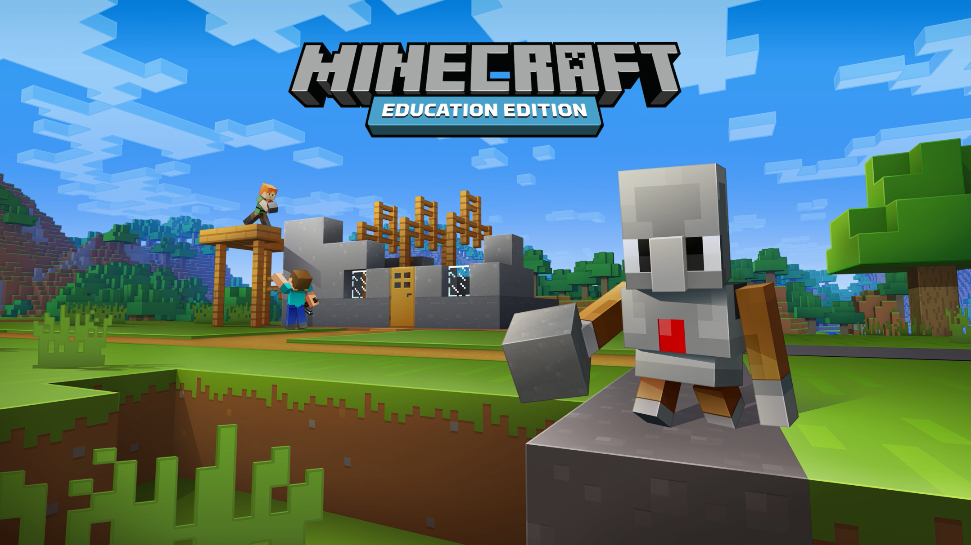
Mock assignment

Slide 2
Mock assignment
Technology: Minecraft educational
Design documentation
Customer brief
Customer requirements (requirements spec)
(you do a lot of thinking)
Proposal (wireframes etc)
Flowchart / pseudocode
Code
Testing
Critical analysis

Slide 3
Design documentation
Customer brief
Rewrite what the customer has asked for
A few sentences
A list of their requirements
Do not include your assumptions (that comes in the next bit)

Slide 4
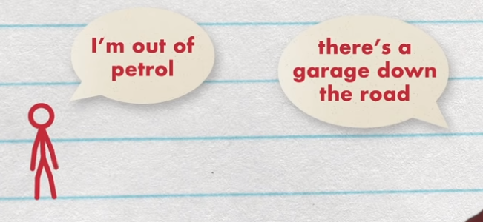
Customer requirements
What the customer is asking
What you are going to deliver
What have they asked for but not explicitly asked for
Assumptions
CRUD
UI
UX
https://youtu.be/IJEaMtNN_dM

Slide 5
Project proposal
This is tricky, so what do you actually write?
Frame the problem – what will you solve and what is out of scope?
Your learning and research
Different solutions you have considered
Details of the chosen solution – visualize it! (Wireframes)
Feedback and revisions

Slide 6
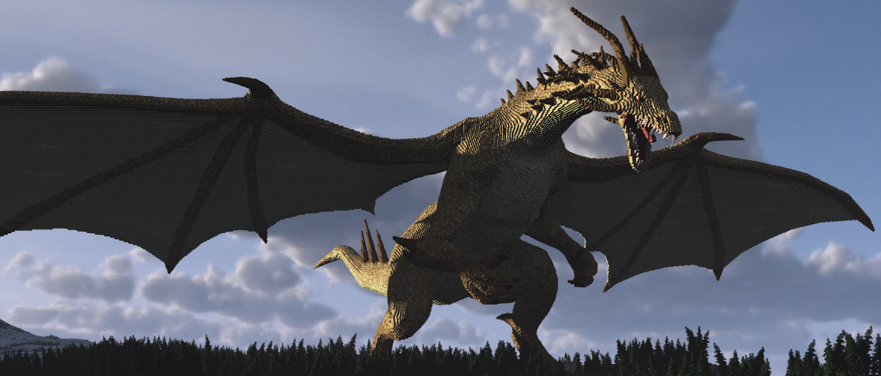
Uther Pendragon
The year is 2070
The world now lives online
Each person has a unique avatar
Minecraft is the glue that holds all worlds together
Uther Pendragon is the best player
His/her real world identity is currently unknown
It is rumoured that Uther once ate 5 pasties for lunch

Slide 7
Uther pendragon
Hello tiny mortal. I have acquired a lot of gold and gems. I require a castle to store my treasure in.
But because I can not tell you the location of my treasure I need the magical incantations (computer code) to build a castle. When I have the magical scripts I will fly to a secret realm and build the castle there.
You are tasked with creating the code to build my castle!

Slide 8
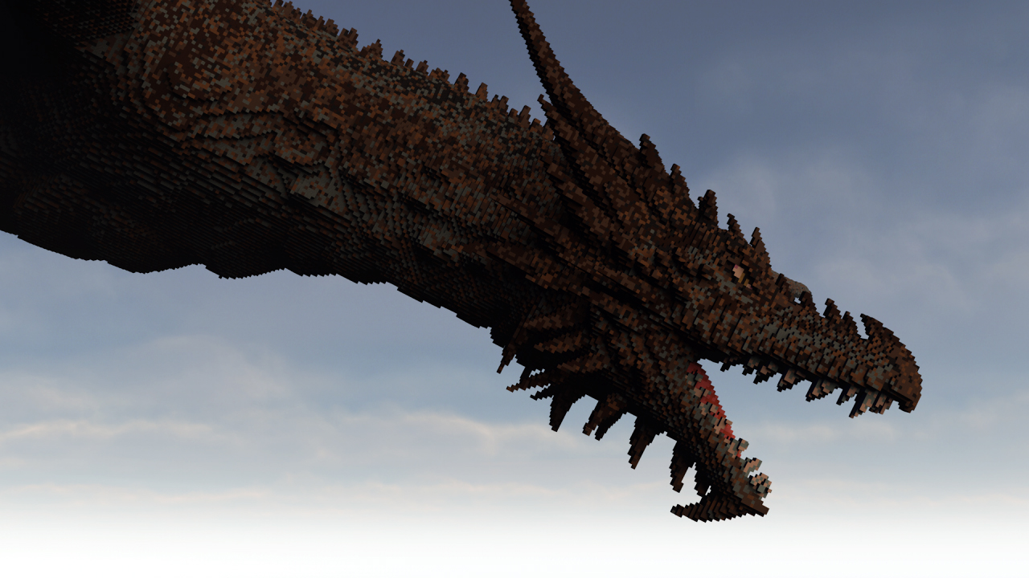
Uther’s requirements
Castle
Width and depth as parameters
Must look, like, really cool and super sick, dude
It should be LGBTQIA+ friendly
Have a salad bar for big salads (Uther is a vegetarian (thank god))
Notes:
Lesbian, Gay, Bi, Trans (non-binary / androgenous), Queer, Intersex, Ally/Asexual, + (everyone else)

Slide 9
Today:
Customer brief
Customer requirements (requirements spec)
(you do a lot of thinking)
Proposal (wireframes / screenshots / prototype) - pitch

Slide 10
Uther’s requirements
Castle
Width and depth as parameters
Must look, like, really cool and super sick, dude
It should be LGBTQIA+ friendly
Have a salad bar for big salads (Uther is a vegetarian (thank god))
Customer brief
Customer requirements (requirements spec)
Proposal (wireframes / screenshots / prototype) - pitch

